Slide 1
ITAI-2373 Natural Language Processing in 2026
Language Understanding in the Era of Large Language Models
-Srikanth Bhakthan
Notes:
We will also look into NLU (Natural Language Understanding) and NLG (Natural Language Generation)

Slide 2
Welcome
Our Goal: To move you from "using" ChatGPT to "building" the agentic AI systems that power it and understanding the mechanics underneath.
Logistics:
Lecture: Monday 5-7pm CST
Lab: Do it at your own pace & time
Office Hours: Ask in Teams/ Canvas email and I will respond as and when I have time

Slide 3
Course Assessment & Expectations
How you will be graded:
Lab Assignments (~35%): Hands-on AI driven coding (Python/Jupyter notebook-Google Colab). You can use your favorite coding agent!
Quiz(~35%): Concepts and Theory.
Final Project (~35%): Building a working NLP/AI/Agent prototype.
Expectations:
This is a fast-moving field. We will learn foundational theory, but we will also experiment with tools that were just released.
Active participation in "Red Teaming" (breaking models) and ethical discussions is required.
Notes:
Openai, codex-max, claude code, Microsoft VS Code with Auto, Gemini 3, Qwen-coder, your choice. Replit, Github Spark, Gemini Apps, Openai Canvas!

Slide 4
The Big Picture

Slide 5
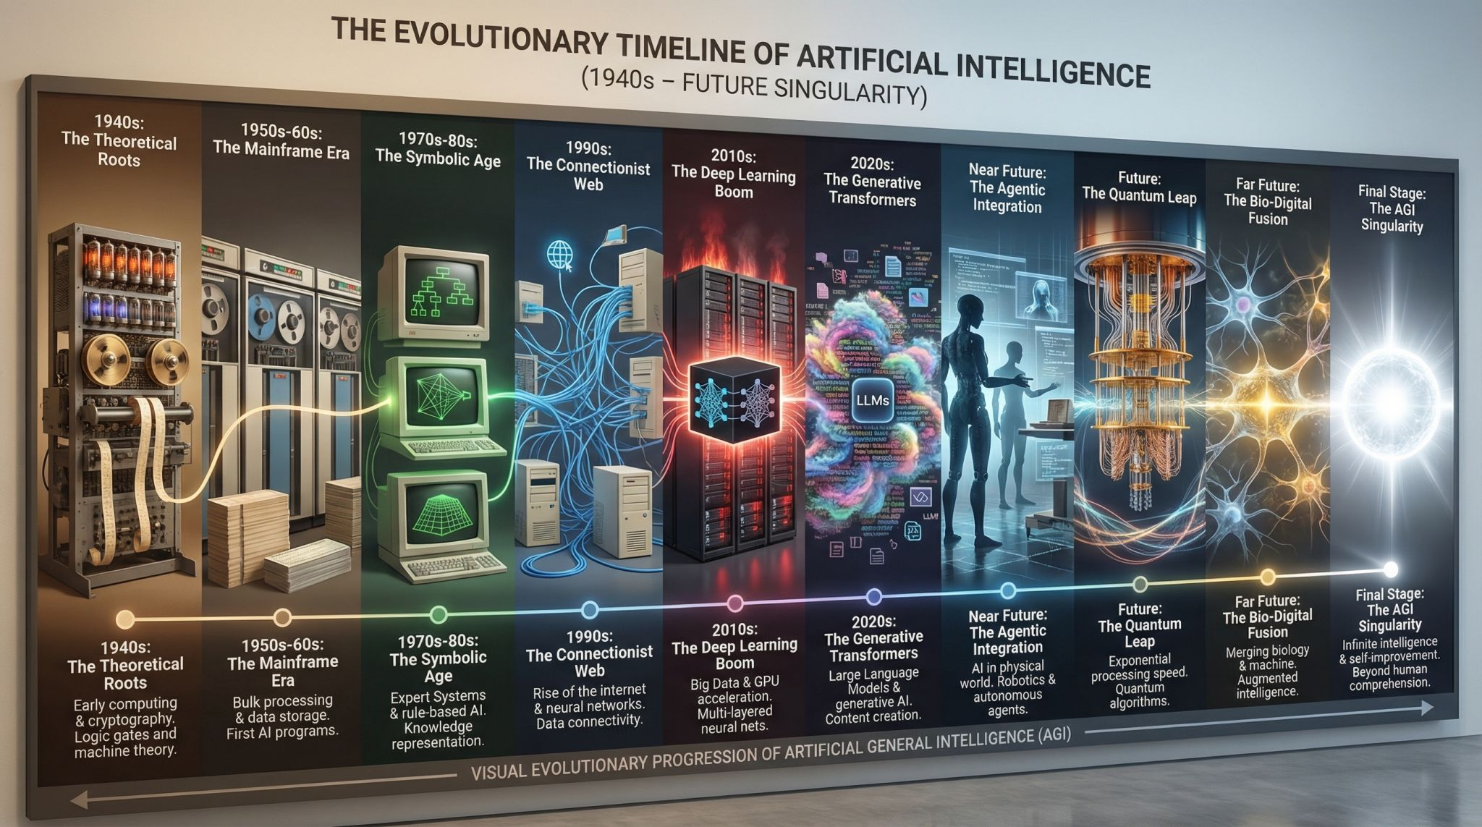
Source: https://www.linkedin.com/posts/bortsova_nano-banana-pro-continues-to-exceed-expectations-activity-7397936766168694784-y9oI

Slide 6
The Robotics Connection
Why does a Robotics major need NLP? (B.A.T)
1. Human-Robot Interaction (HRI):
"Robot, go to the kitchen and fetch the red mug." (Voice to Action).
2. Knowledge Retrieval:
Robots reading manuals to learn how to fix machinery.
3. Multimodality:
Modern AI sees, hears, and speaks.
NLP is the bridge between these modalities.
Notes:
Robotics Context: Constantly tie the concepts back to robotics. When discussing "Ambiguity", ask: "If a robot hears 'Pick up the bat', does it look for a baseball bat or a flying mammal?"
Gemini ER model (embodied reasoning)

Slide 7
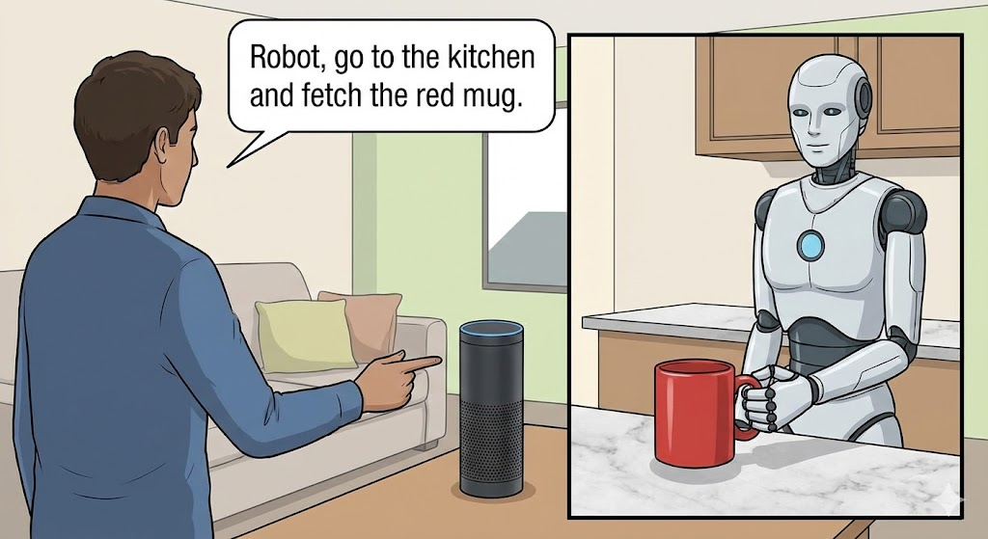
1. Human-Robot Interaction (HRI)
The integration of LLMs in robotics allows for more natural and intuitive human-robot interaction.
A user can give a complex, natural language command, and the robot, powered by an LLM,
can interpret the intent and translate it into a sequence of actions.
Notes:
Human-Robot Interaction (HRI). This image shows a person giving the voice command "Robot, go to the kitchen and fetch the red mug" to a smart speaker. The robot in the other panel has understood the command, navigated to the kitchen, and is in the process of picking up the correct red mug, demonstrating the "Voice to Action" capability.

Slide 8
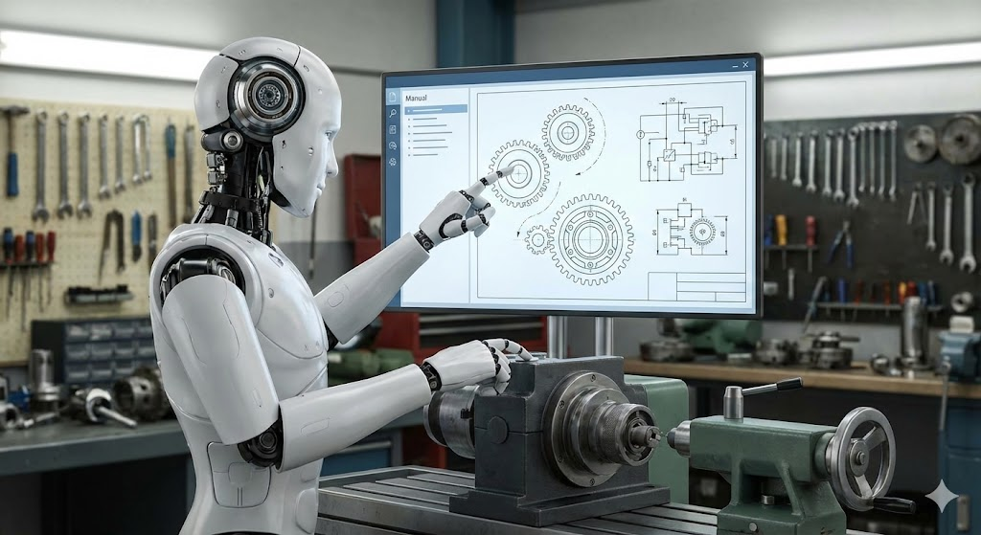
2. Knowledge Retrieval
Robots often need to perform tasks in dynamic environments or on complex machinery.
LLMs can act as a vast knowledge base, allowing robots to "read" manuals, technical documents, or online tutorials to learn how to fix a machine or perform a new task, without being explicitly programmed for it.
Notes:
Knowledge Retrieval. A robot in a workshop is shown consulting a digital technical manual on a monitor while simultaneously working on a piece of industrial machinery. The robot is actively using the knowledge retrieved from the manual to guide its actions.

Slide 9
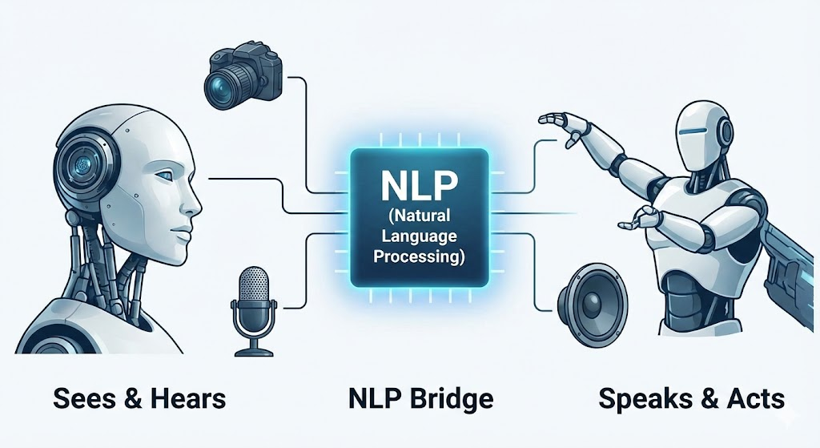
3. Multimodality
Modern Robotics is moving towards multimodal AI, where a robot can perceive the world through various senses like vision and hearing.
Then use NLP as a central “brain” to process this information and decide on the appropriate action, including speaking back to human.
Notes:
Multimodality. This conceptual diagram illustrates the robot's ability to "see" with a camera and "hear" with a microphone. These sensory inputs are processed by the central "NLP Bridge," which then directs the robot to "speak" via a speaker and perform physical "actions."

Slide 10
The Paradigm Shift

Slide 11
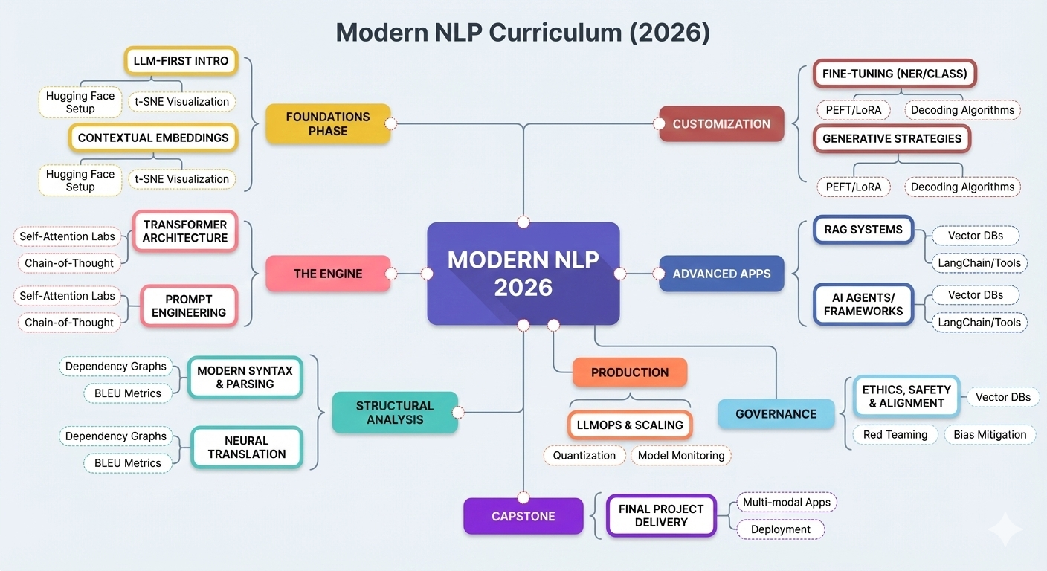

Slide 12
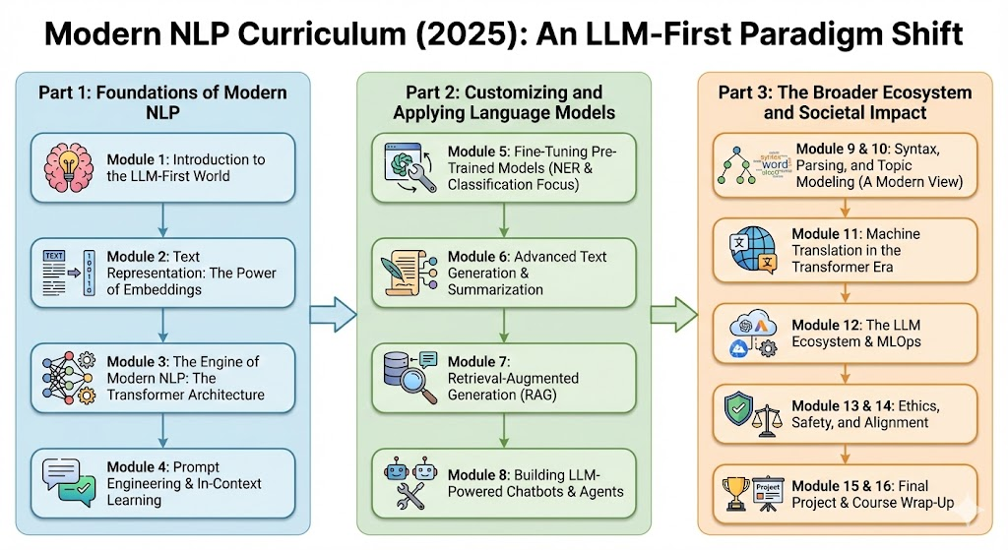
6
Notes:
We live in a world where we are driven by language more than anything else in communication between humans. Any system we created are mostly established with the language constructs as the base (English).

Slide 13
What is Natural Language Processing?
Definition: A subfield of AI giving computers the ability to understand, interpret, and generate human language.
The Challenge: Human language is ambiguous, messy, and context-dependent.
Example: "I saw the man with the telescope." (Did I have the telescope? Or did the man?)
Example: "Bank" (River? Money? Turning a plane?)

Slide 14
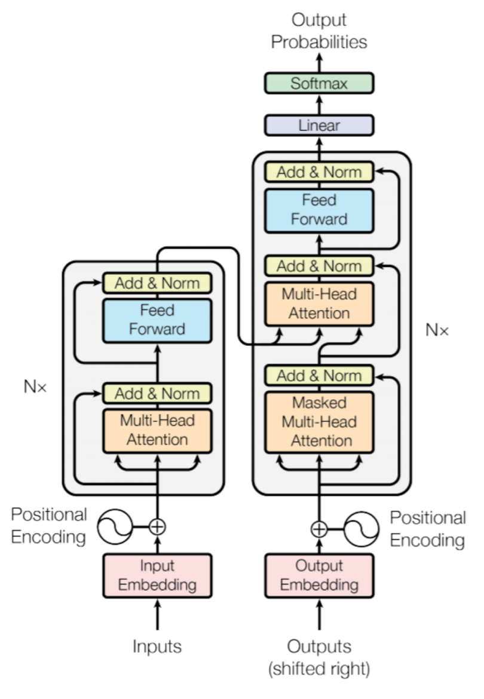
The "Two Eras" of NLP
Era 1: Pre-Transformer (1950s - 2017)
Rule-based systems, Statistical models, and Recurrent Neural Networks (RNNs).
Characteristics: Task-specific models (one model for translation, a different one for sentiment). Hard to scale.
Era 2: Post-Transformer (2017 - Present)
The rise of the Transformer architecture and LLMs (GPT, BERT, Llama).
Characteristics: General-purpose models. One model can translate, summarize, and code.

Slide 15
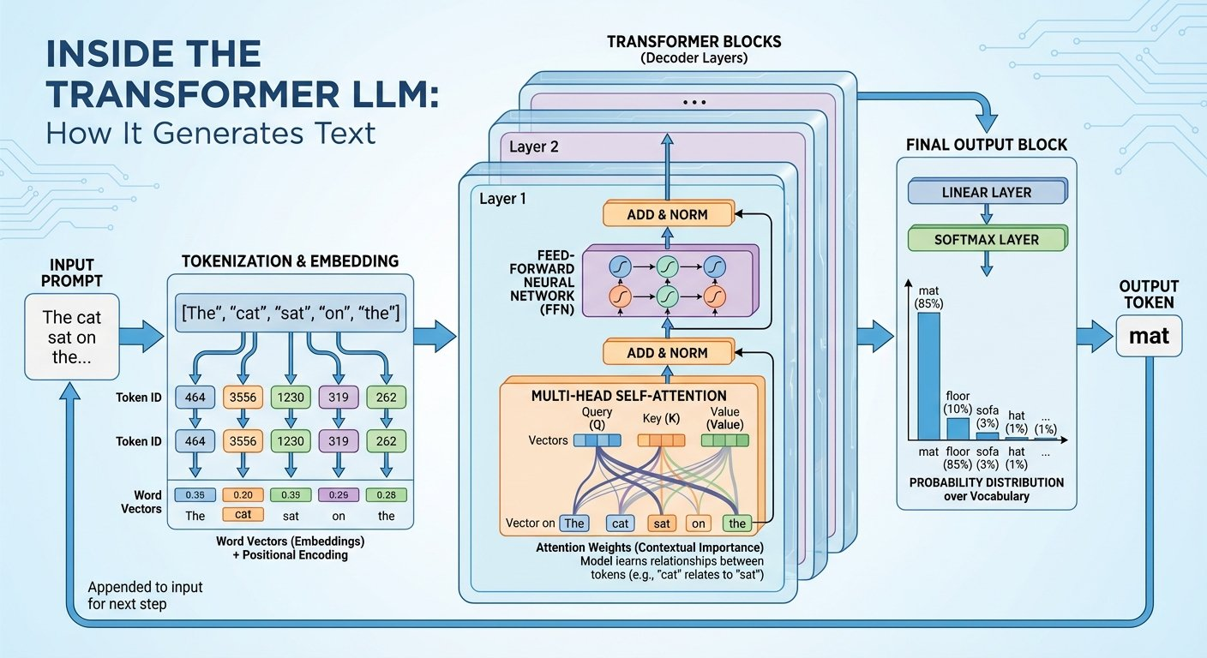
Image Credit: https://x.com/NanoBanana/status/1991619646185963938?s=20

Slide 16
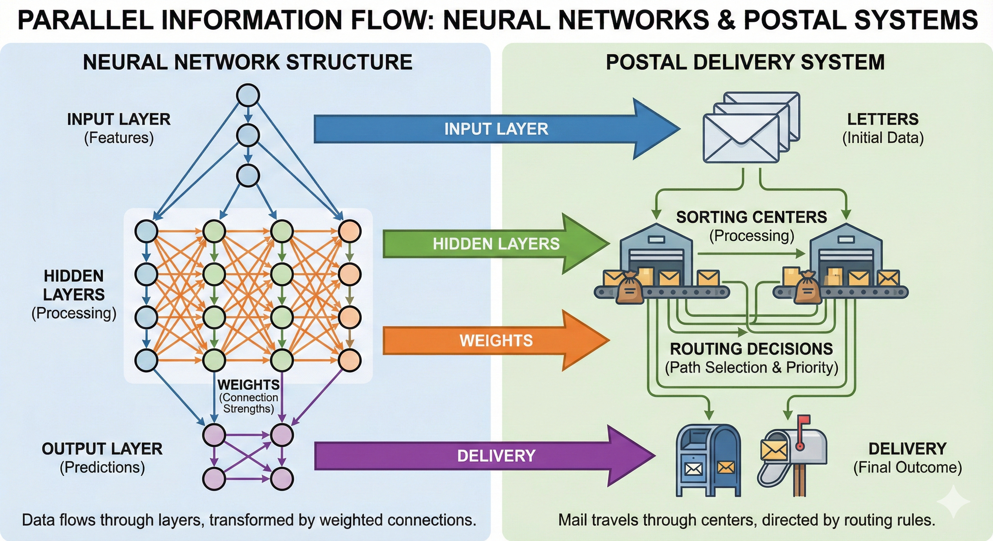
Source: https://substack.com/home/post/p-180681487

Slide 17
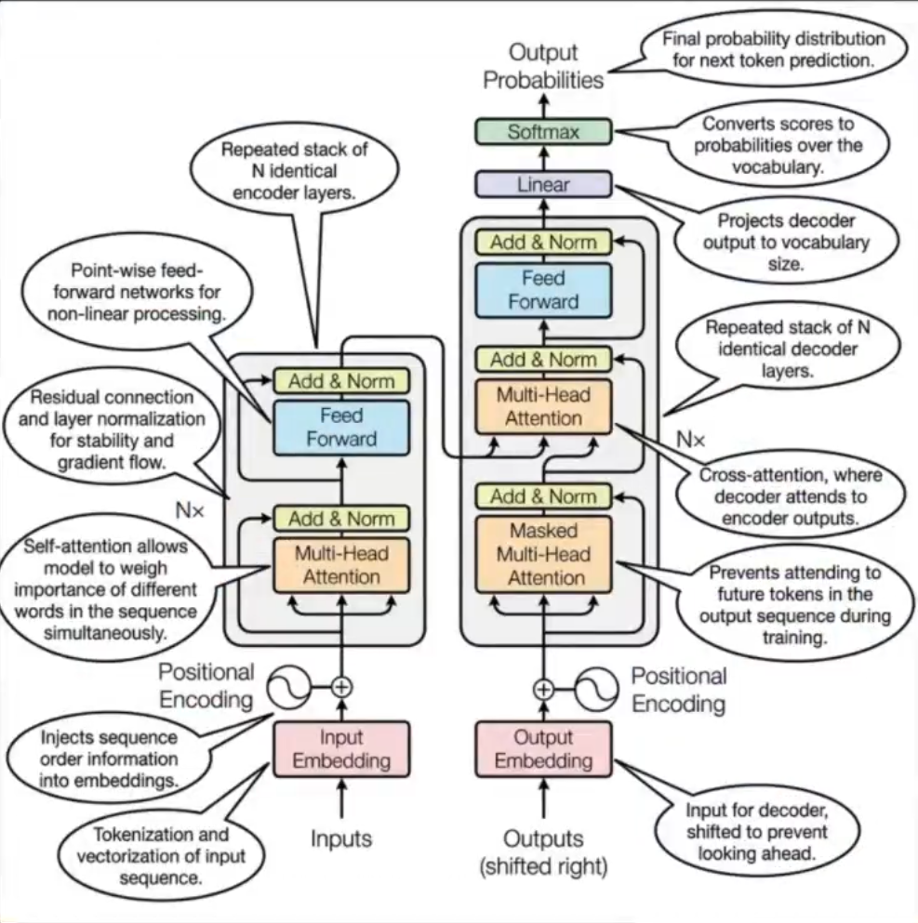
Image Credit – Nano Banana - https://x.com/omarsar0/status/1991919404435820768?s=20
Notes:
Use Nano Banana Pro: Annotate the original Transformer architecture diagram. What we just did is the technical visual communication, that helps understanding and improve your way of communication and bring in the visual details much more granular for the non-deep learners!

Slide 18
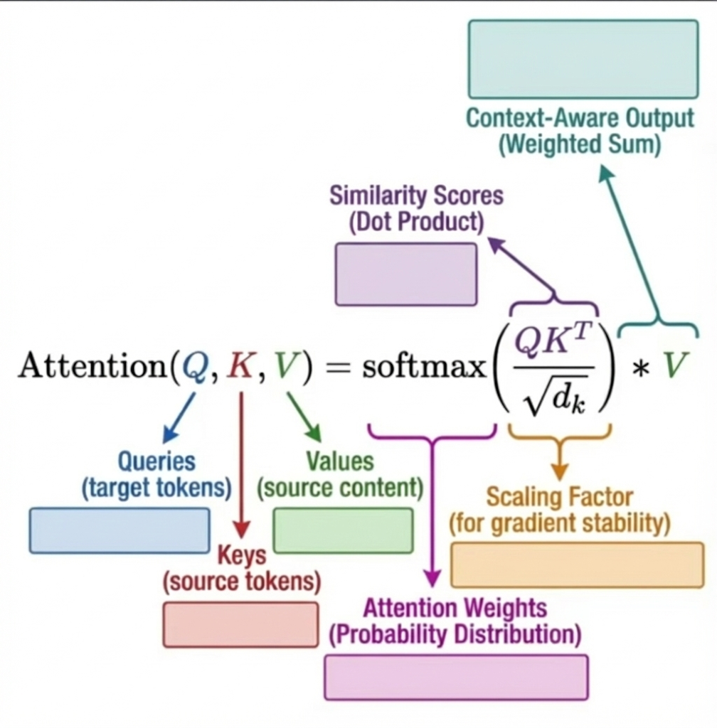
Notes:
Prompt: Generation requires learners to produce an answer, explanation, or prediction before seeing the correct one. Research shows that generating produces stronger memory than passive exposure. Using this image outline, create an unlabeled or partially revealed diagram of X that requires learners to generate missing steps or labels. Leave intentional gaps aligned to the student learning objectives

Slide 19
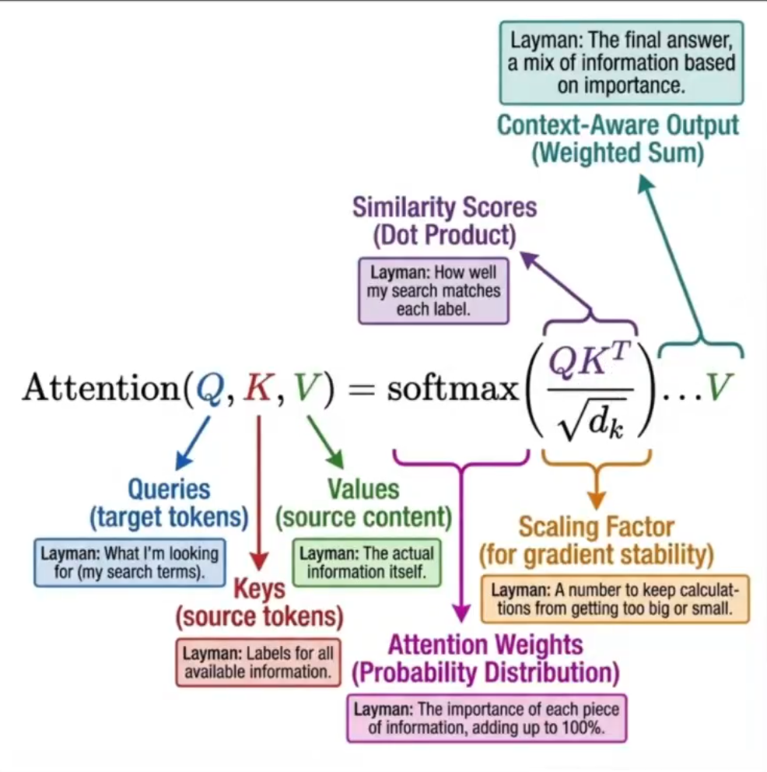
Image Credit – Nano Banana - https://x.com/omarsar0/status/1991911424868970662?s=20

Slide 20
The Evolution Timeline
1950s
Turing Test & Rule-based translation.
1990s
Statistical NLP (Probabilities).
2013
Word2Vec (Words as math vectors).
2017
Attention Is All You Need" (The Transformer Paper).
2022
ChatGPT (RLHF & Mass Adoption).
2025
Multimodal Agents (Action-oriented AI).

Slide 21
The Paradigm Shift: Computing
Traditional Programming:
Input + Explicit Rules (Code) = Output.
Traditional Machine Learning:
Input + Output Data = Learned Rules.
The LLM Paradigm (Prompting):
Natural Language Instruction + Context = Reasoning & Output.
Takeaway: English is becoming the hottest new programming language.
Notes:
How is this all possible?

Slide 22
Software behind Hardware
Notes:
NVIDIA & Google & AWS & Microsoft
I’m going to skip AWS (Trainium & Inferentia) and Microsoft (Maia & Cobalt) for the day

Slide 23
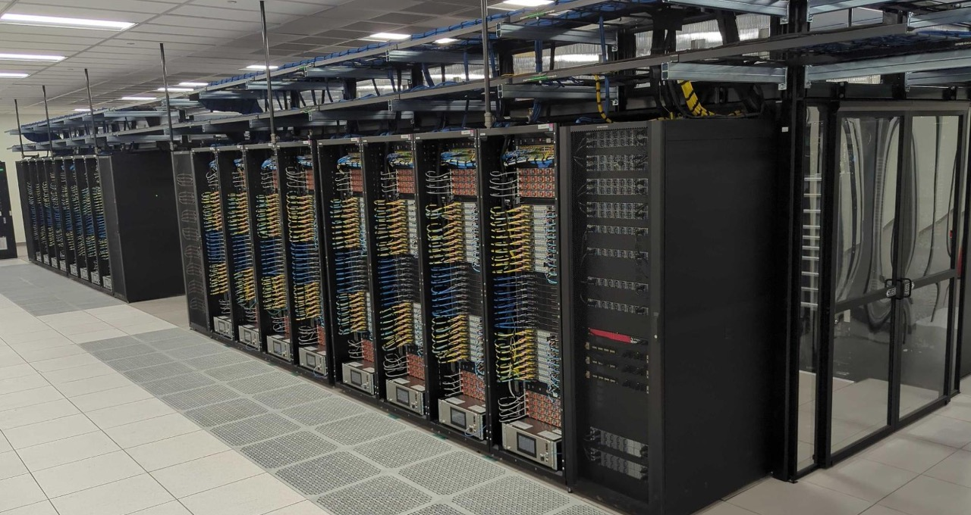
https://resources.nvidia.com/en-us-blackwell-architecture/blackwell-ultra-datasheet

Slide 24
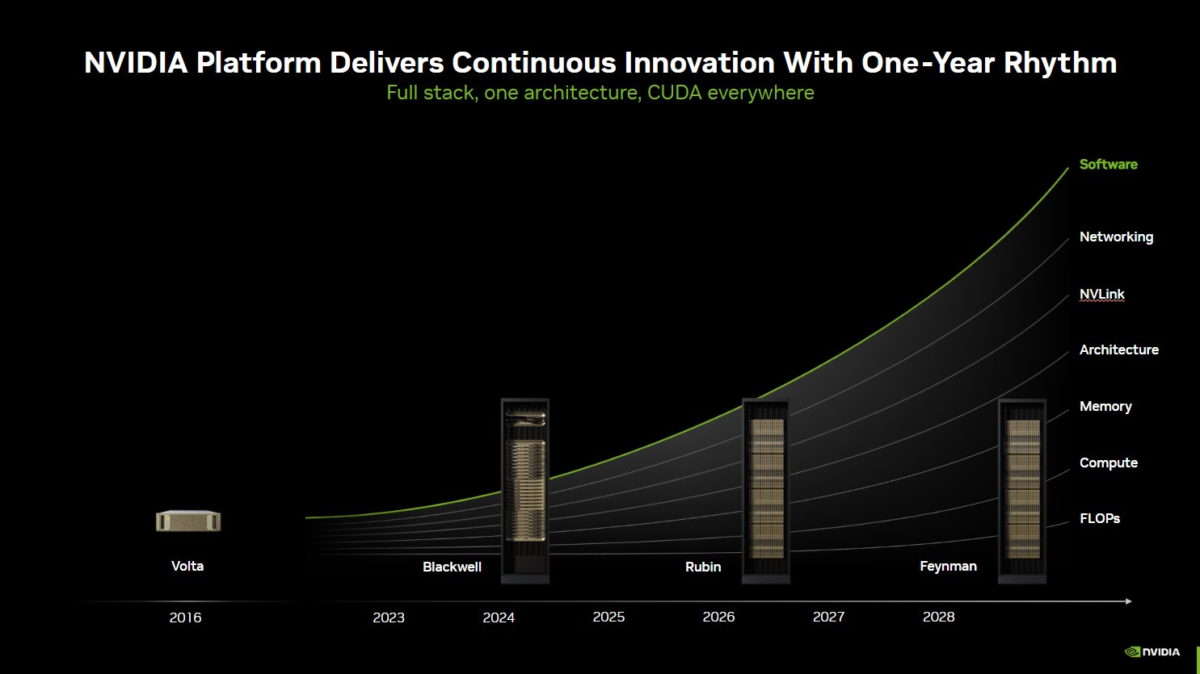
Notes:
Quarterly Earnings NVIDIA Nov 2025 – A decade long change is happening in a year in hardware side NVIDIA delivers innovation at a one-year rhythm, advancing accelerated computing from Volta to Blackwell, Rubin, and soon Feynman. With each new architecture, the NVIDIA platform delivers a full stack—compute, memory, NVLink, networking, and software all unified by CUDA. This extreme co-design has unlocked a 10x performance leap with Blackwell and enabled 10x revenue potential for customers

Slide 25
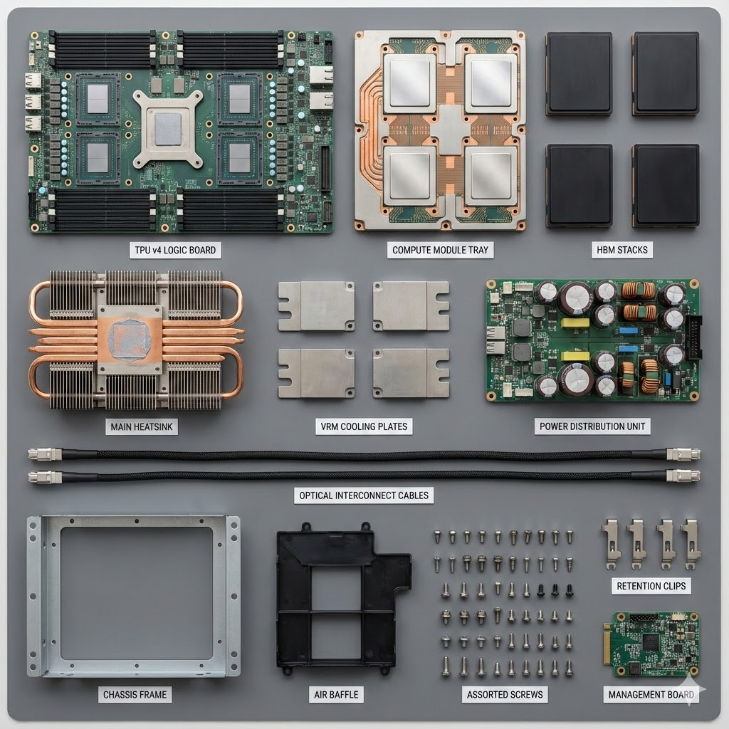
TPU Knolling by Nano Banana
https://cloud.google.com/tpu
Notes:
Google’s Next Platform- v7 - "An Ironwood cluster linked with Google’s absolutely unique optical circuit switch interconnect can bring to bear 9,216 Ironwood TPUs with a combined 1.77 PB of HBM memory in comparison to rack scale of Nvidia system based on 144 “Blackwell” GPU chipsets with an aggregate of 20.7 TB of HBM memory. Read: Inside the Google’s Ironwood TPU v7 Supply Chain - https://substack.com/home/post/p-179832133
SemiAnalysis Read: https://newsletter.semianalysis.com/p/tpuv7-google-takes-a-swing-at-the

Slide 26
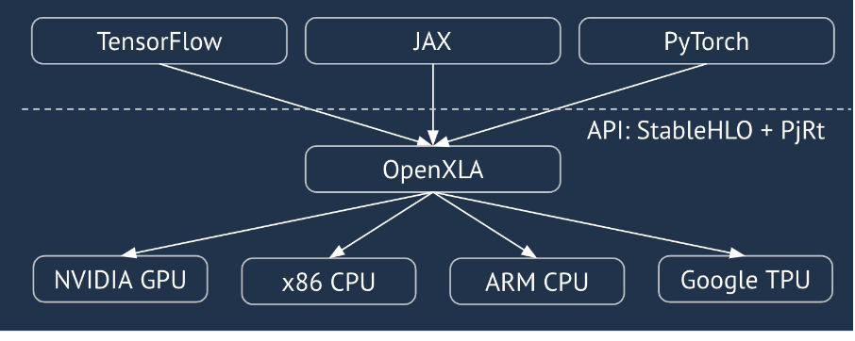
XLA - Accelerated Linear Algebra
https://github.com/jax-ml/jax
https://openxla.org/xla/gpu_architecture
Notes:
JAX is an open-source Python library developed by Google for high-performance numerical computing and large-scale machine learning. It is designed for accelerator-oriented array computation and program transformation, making it particularly suitable for tasks involving GPUs and TPUs. Key features and characteristics of JAX:
NumPy-like Interface:
JAX aims to provide a familiar and intuitive interface similar to NumPy for array operations and numerical computations.
Automatic Differentiation (Autodiff):
JAX offers robust automatic differentiation capabilities, allowing for efficient calculation of gradients for optimization and machine learning tasks. The grad transformation is a core feature for this.
Just-In-Time (JIT) Compilation:
JAX leverages OpenXLA, an open-source machine learning compiler ecosystem, to perform JIT compilation of Python code into optimized executables, leading to significant performance improvements. The jit transformation enables this.
Automatic Vectorization (Vmap):
JAX provides the vmap transformation for automatically vectorizing functions, allowing for efficient processing of batches of data or parallel computations.
Parallelization (Pmap):
JAX supports parallel computation for Single Program, Multiple Data (SPMD) programs using the pmap transformation, facilitating scaling across multiple accelerator devices.
Composable Transformations:
JAX's design emphasizes composable function transformations, enabling the nesting and combination of features like grad, jit, vmap, and pmap for complex operations.
Focus on Functional Programming:
JAX's core design leans towards functional programming principles, which can enhance code clarity and enable powerful transformations.
Ecosystem of Tools:
JAX is part of a broader ecosystem including libraries like Flax (for neural networks), Optax (for optimization), and Orbax (for checkpointing), offering a comprehensive set of tools for machine learning development.

Slide 27
Deconstructing the Pipelines

Slide 28
The Traditional NLP Pipeline (The "Old" Way)
We still use this for specific, low-cost tasks.
Step 1: Preprocessing (Cleaning, Tokenizing).
Step 2: Feature Extraction (Counting words, looking for patterns).
Step 3: Model (Logistic Regression, SVM).
Step 4: Output (Class Label).
Pros: Fast, cheap, transparent.
Cons: Can't write poetry or understand deep nuance.
https://ai.studio/apps/drive/1xyTLooNlIVa5zHkI6id3yXmVLb9zuBMP
Notes:
the "Old Way" is not dead. It is now the foundation for the "New Way." You cannot build a good RAG system (Slide RAG) without understanding text chunking and vectors.

Slide 29
The Modern NLP Pipeline (The "New" Way)
Step 1: Prompt Engineering (Designing the instruction).
Step 2: Context Injection (Adding relevant data/documents).
Step 3: Black Box Inference (The LLM does the heavy lifting).
Step 4: Output Parsing (Formatting the text back into data).
Pros: Incredible capabilities, handles unseen tasks.
Cons: Expensive, "Black Box" (hard to explain why), Hallucinations.
https://ai.studio/apps/drive/1xyTLooNlIVa5zHkI6id3yXmVLb9zuBMP

Slide 30
Anatomy of a Modern App (The RAG Architecture)
How do we combine the two?
Scenario: A Chatbot that answers questions about our University Guidelines.
Visual Diagram:
User Question ->
Search (Using Embeddings/Vectors) ->
Retrieve relevant pages ->
Send Question + Pages to LLM ->
Answer.
Note: To build this, you need to understand: Tokenization and Embeddings (Future Modules).

Slide 31
Why Learn the Fundamentals?
If LLMs are so good, why learn Tokenization or Syntax?
1. Cost & Latency: You don't need GPT-4 to classify spam. A simple model is 1000x cheaper and faster.
2. Context Window: LLMs have limits. You need efficient ways (cleaning/preprocessing) to feed them data.
3. Debugging: When the LLM fails, you need to look under the hood.
4. Fine-Tuning: To customize an LLM, you need to understand training loops and data preparation.
Notes:
Ask: What can I do on-device. What can I do to measure Intelligence per Watt or Intelligence Per Joule to get my task done?

Slide 32
Tools & Lab Intro

Slide 33
The Tool stack for this Course
Python: The language of AI.
Hugging Face (Transformers): The "GitHub of AI" – our source for models and datasets.
PyTorch: The deep learning framework.
SpaCy / NLTK: The Swiss-army knives for text processing.
Agent Framework (MSFT)/ LangChain / Openai-agents / Pydantic-ai/ Google-ADK/ Build or Pick your own: For building chains and agents.

Slide 34

Ethics First
Great Power = Great Responsibility.
Bias: Models learn from the internet. The internet is biased.
Hallucination: Models can lie confidently.
Safety: We will discuss how to prevent models from generating harmful content.

Slide 35
Lab Preview: Today's Objective
Goal 1: The "Wow" Factor.
Download a Transformer model from Hugging Face.
Perform Sentiment Analysis and Translation in 3 lines of code.
Goal 2: The Mechanics.
Use NLTK to break a sentence into "Tokens" (words).
Compare how an LLM sees text vs. how a human sees text.

Slide 36
Lab Setup
Environment: Google Colab (Cloud) or Local Jupyter Notebook.
Account: Sign up for Hugging Face (it's free).
Library Installation:
pip install transformers
pip install nltk
pip install spacy

Slide 37
Example: The Hugging Face "Pipeline"
from transformers import pipeline
classifier = pipeline("sentiment-analysis")
result = classifier("I love studying AI and NLP in 2025!")
print(result)
# Output: [{'label': 'POSITIVE', 'score': 0.99}]
Notes:
Discussion: What just happened? (Download -> Load Weights -> Preprocess -> Inference -> Postprocess).

Slide 38
Before Next Week
Read: "The Illustrated Transformer" (Blog post link)
Watch: Transformer Explained with Historical reference (2025)
Topic: We dive into Text Preprocessing – Cleaning the data before the AI sees it.
Q&A

Slide 39
Business Use cases: Real world ML and LLM Systems: https://www.evidentlyai.com/ml-system-design
Microsoft:
https://github.com/microsoft/generative-ai-for-beginners
GitHub:
https://github.com/keon/awesome-nlp
https://github.com/awesomelistsio/awesome-nlp
Google:
https://developers.google.com/machine-learning/crash-course/embeddings
Notes:
Additional Read- Why google is positioned to win AI race in the long term - https://news.ycombinator.com/item?id=46069048

